Slide 1
Genetic Progress- Bull Class (HO)
The chart is the genetic trend for NM$ by bull class
The ABS group is very competitive in genetic rank
It takes 100s of bulls to supply genetics to our customers and those in the top 100 can only supply a small portion, which is why it is important to look at the whole group.
Although we illustrate in NM$, we believe that customers should have a genetic plan that matches their goals
NM$
For ABS, 29HO stud code U.S. based bulls were used for the averages, the STJ product line was not included

Slide 2
Genetic Progress- Bull Class (JE)
The chart is the genetic trend for CM$ by bull class
It takes many Jersey bulls to supply genetics to our customers and those in the top 40 can only supply a small portion, which is why it is important to look at the whole group.
The average of the group of bulls marketed by ABS leads the industry!
Although we illustrate in CM$, we believe that customers should have a genetic plan that matches their goals
NM$
For ABS, 29JE stud code U.S. based bulls were used for the averages, the STJ product line was not included

Slide 3
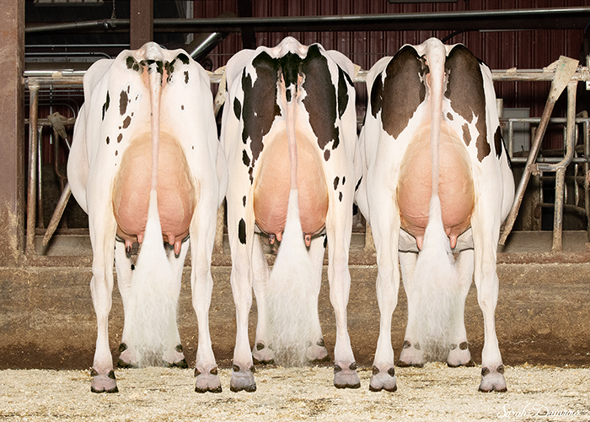
April 2025 Polled Line Up
ABS is the only stud that can offer a fully polled herd solution
ABS markets 15 of the top 20 PP bulls ($735+ NM$)
Our top 10 PP bulls average $822 NM
The future of ABS polled is very bright!
25 industry marketed P bulls are over $870 NM; 18 are at ABS and they average $935 NM!
These P bulls give us the building blocks for an ever-strengthening PP lineup in the future

